Slide 1

Alard college of engineering and management
Department of Artificial Intelligence and machine learning
BE-AIML Academic Year (2024-2025)
Lab Practice V (Natural Language Processing)
Mini Project on
“POS Tagging and Translation for Multiple Languages”
Roll No. | Name
02 | Samruddhi Sandip Kangude

Slide 2
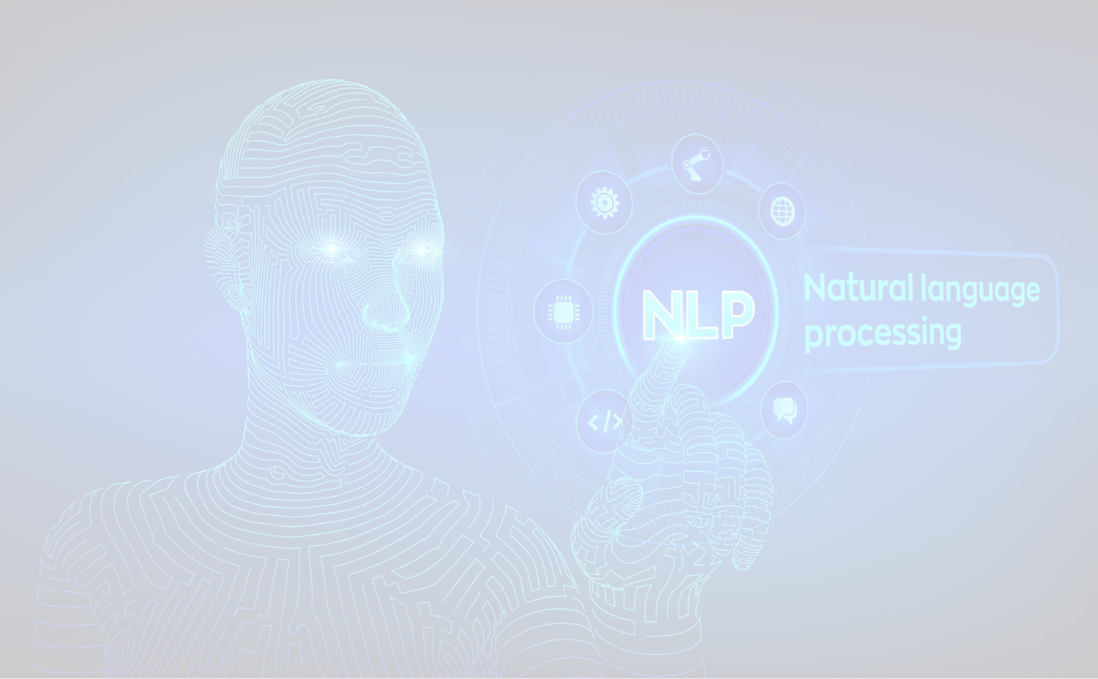
POS Tagging and Translation for Multiple Languages.

Slide 3
1. Introduction
Part-of-Speech (POS) tagging assigns grammatical labels to words (e.g., noun, verb) and is vital for understanding the structure of language in NLP. Translation,
On the other hand, enables multilingual communication by converting text from one language to another while preserving meaning. This project combines translation and POS tagging into a unified workflow for multiple Indian languages, supporting deeper linguistic analysis and cross-language NLP applications.

Slide 4
2. What is Translation with POS Tagging?​
Translation with POS tagging integrates machine translation and Part-of-Speech tagging. POS tagging assigns grammatical labels (noun, verb, etc.) to words, crucial for NLP tasks like sentiment analysis.
Combining these enhances multilingual text processing and linguistic accuracy. This unified approach addresses the demand for tools efficiently processing diverse languages. It supports languages like Hindi, Marathi, Urdu, Tamil and performs POS tagging on translated text.

Slide 5
3. Motivation​​
Increasing need for multilingual NLP tools due to globalization and digital communication.
Limited tools available for processing non-English and Indian languages effectively.
Encouraging NLP development in Indian languages like Hindi, Marathi, Tamil, etc., is crucial for inclusive AI applications.

Slide 6
4. Problem Statement​​​
Aim: To develop an integrated NLP tool that performs both translation and POS tagging efficiently, with a focus on supporting multiple Indian languages.
Goal:
To enhance linguistic research and application development for Indian languages through robust language processing support.
To provide a scalable, accessible solution for developers, researchers, and educators working with multilingual data.

Slide 7
5. Objective​​​​s
Detects the language of input text.
Translates English text into multiple Indian languages.
Performs POS tagging on the translated outputs.
Ensures ease of use, support for multiple languages, and efficiency.
It shows POS Tagging Noun, Adjective, and Pro-Noun and Verb.

Slide 8
6. Software and Hardware Requirements​​​​​
Software: Jupyter Notebook version 7.3.3
Hardware: Computer System ,Windows 64 bit OS, Min 4GB RAM

Slide 9
7. Algorithm​​​
​​​
​
Step 1: Import required libraries.
Step 2: Detect input text language with langdetect.
Step 3: Translate English input to target languages using google trans.
Step 4: Tokenize translated text using nltk.word_tokenize.
Step 5: Perform POS tagging using nltk.pos_tag.
Step 6: Display translated text and POS tags for each language.

Slide 10
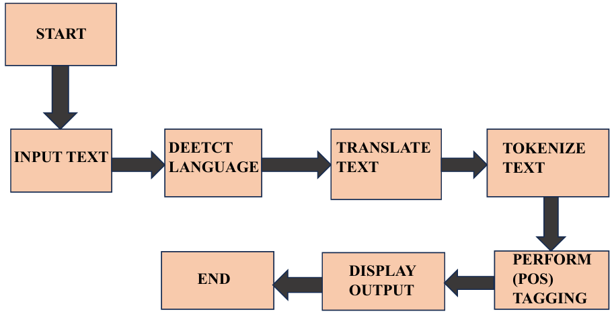
8. Flowchart​​​​​​

Slide 11
9. Applications​​​​​​​
Multilingual Chatbots & Virtual Assistants
Language Learning Apps
Voice Assistants (e.g., Google Assistant, Siri)
Real-Time Translation in Messaging Apps
Emergency & Healthcare Communication Tools

Slide 12
10. Conclusion
POS Tagging and Translation together enhance cross-language communication by enabling accurate and context-aware language processing. This integration is especially valuable for real-time applications like chatbots and language tools. For resource-scarce Indian languages, it bridges gaps in NLP capabilities, improves sentiment analysis and accessibility, and supports the development of smarter, inclusive multilingual systems.

Slide 13
11. References
https://www.netguru.com/glossary/part-of-speech-tagging-artificial-intelligence-explained
https://localizejs.com/articles/natural-language-processing-nlp
https://stackoverflow.com/questions/32740988/multilingual-nltk-for-pos-tagging-and-lemmatizer
https://arxiv.org/abs/2210.09840
https://www.cogentinfo.com/resources/lost-in-translation-the-biggest-mistakes-multilingual-nlp-still-makes
https://payodatechnologyinc.medium.com/top-use-cases-of-natural-language-processing-nlp-in-2024-a557bae5866e
https://waywithwords.net/resource/nlp-in-speech-data-analysis-insights/

Slide 14


